Slide 1

Welcome to English Class 5/4
Let's go 2A
Teacher : Ngo Thi Thanh Hang

Slide 2
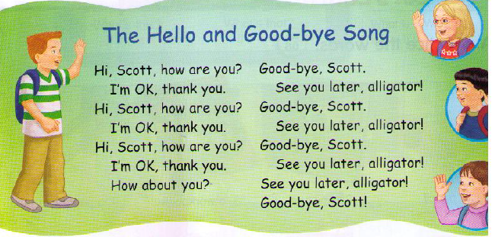

Wednesday, October 24th ,2018.

Slide 3

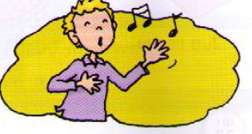

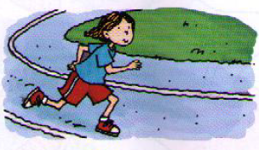
Wednesday, October 24th ,2018.
Unit 2: MY THINGS
* Review the previous lesson :
Look at the pictures and make the sentences:
1
2
3
4

Slide 4
1
2
He can sing
She can dance
3
4
He can swim
She can run

Slide 5
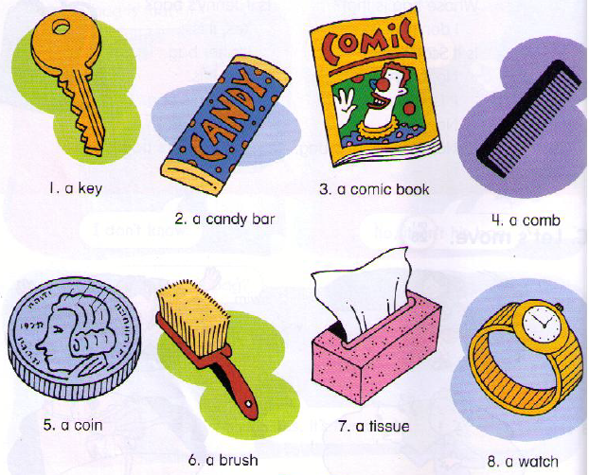
Wednesday, October 24th ,2018.
Unit 2: MY THINGS

Slide 6
Wednesday, October 24th ,2018.
Unit 2: MY THINGS
Let’s learn
A. Practice the words.

Slide 7

Wednesday, October 24th ,2018.
Unit 2: MY THINGS
Let’s learn
A. Practice the words.
a key

Slide 8
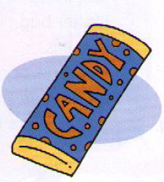
Wednesday, October 24th ,2018.
Unit 2: MY THINGS
Let’s learn
A. Practice the words.
a candy bar

Slide 9

Wednesday, October 24th ,2018.
Unit 2: MY THINGS
Let’s learn
A. Practice the words.
a comic book

Slide 10
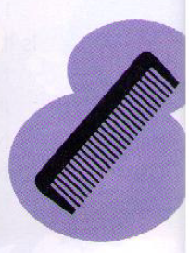
Wednesday, October 24th ,2018.
Unit 2: MY THINGS
Let’s learn
A. Practice the words.
a comb

Slide 11
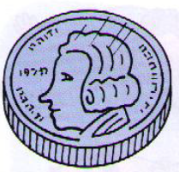
Wednesday, October 24th ,2018.
Unit 2: MY THINGS
Let’s learn
A. Practice the words.
a coin

Slide 12
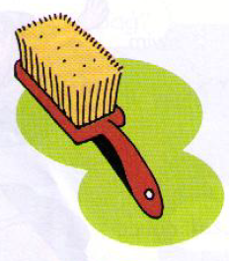
Wednesday, October 24th ,2018.
Unit 2: MY THINGS
Let’s learn
A. Practice the words.
a brush

Slide 13
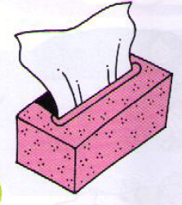
Wednesday, October 24th ,2018.
Unit 2: MY THINGS
Let’s learn
A. Practice the words.
a tissue

Slide 14
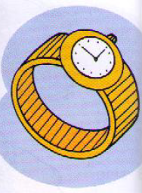
Wednesday, October 24th ,2018.
Unit 2: MY THINGS
Let’s learn
A. Practice the words.
a watch

Slide 15


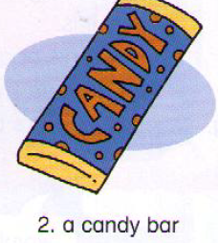
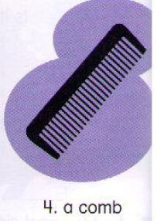
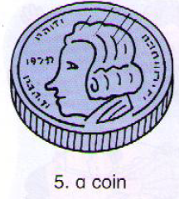
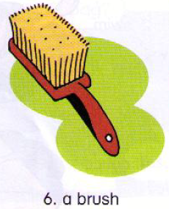
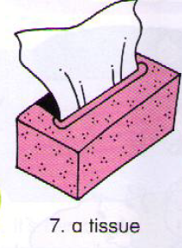
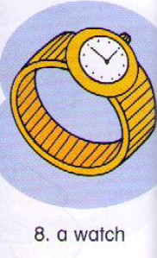
Wednesday, October 24th ,2018.
Unit 2: MY THINGS
Let’s learn
A. Practice the words.

Slide 16
Wednesday, October 24th ,2018.
Unit 2: MY THINGS
Let’s learn
A. Practice the words.

Slide 17
Wednesday, October 24th ,2018.
Unit 2: MY THINGS
Let’s learn
A. Practice the words.
Practice in pairs (2 minutes)

Slide 18
Wednesday, October 24th ,2018.
Unit 2: MY THINGS
Let’s learn
A. Practice the words.

Slide 19
Crossword puzzle
1
w | a | t | c | h
2
b | r | u | s | h
3
c | o | i | n
4
c | a | n | d | y | b | a | r
5
b | a | g
6
t | i | s | s | u | e

Slide 24
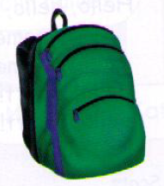

Slide 26
Wednesday, October 24th ,2018.
Unit 2: MY THINGS
Let’s learn
A. Practice the words.

Slide 27
Wednesday, October 24th ,2018.
Unit 2: MY THINGS
Let’s learn
A. Practice the words.
* New words :
1. a key .
5. a coin .
2. a candy bar.
6. a brush.
3. a comic book.
7. a tissue.
4. a comb.
8. a watch.

Slide 28
Wednesday, October 24th ,2018.
Unit 2: MY THINGS
Let’s learn
HOMEWORK
-Learn the lesson by heart.
-Prepare for next part.

Slide 29

Thank you very much.

